Slide 1
Mobile Robotic Arm
Tianshu Bao
Shawn Stern
Dan Tran

Slide 2
The Team – Tianshu Bao
Major in EE, Embedded System and VLSI
Previous Hardware Testing Engineer at Cisco
Software Developer at Expedia
Traveler

Slide 3
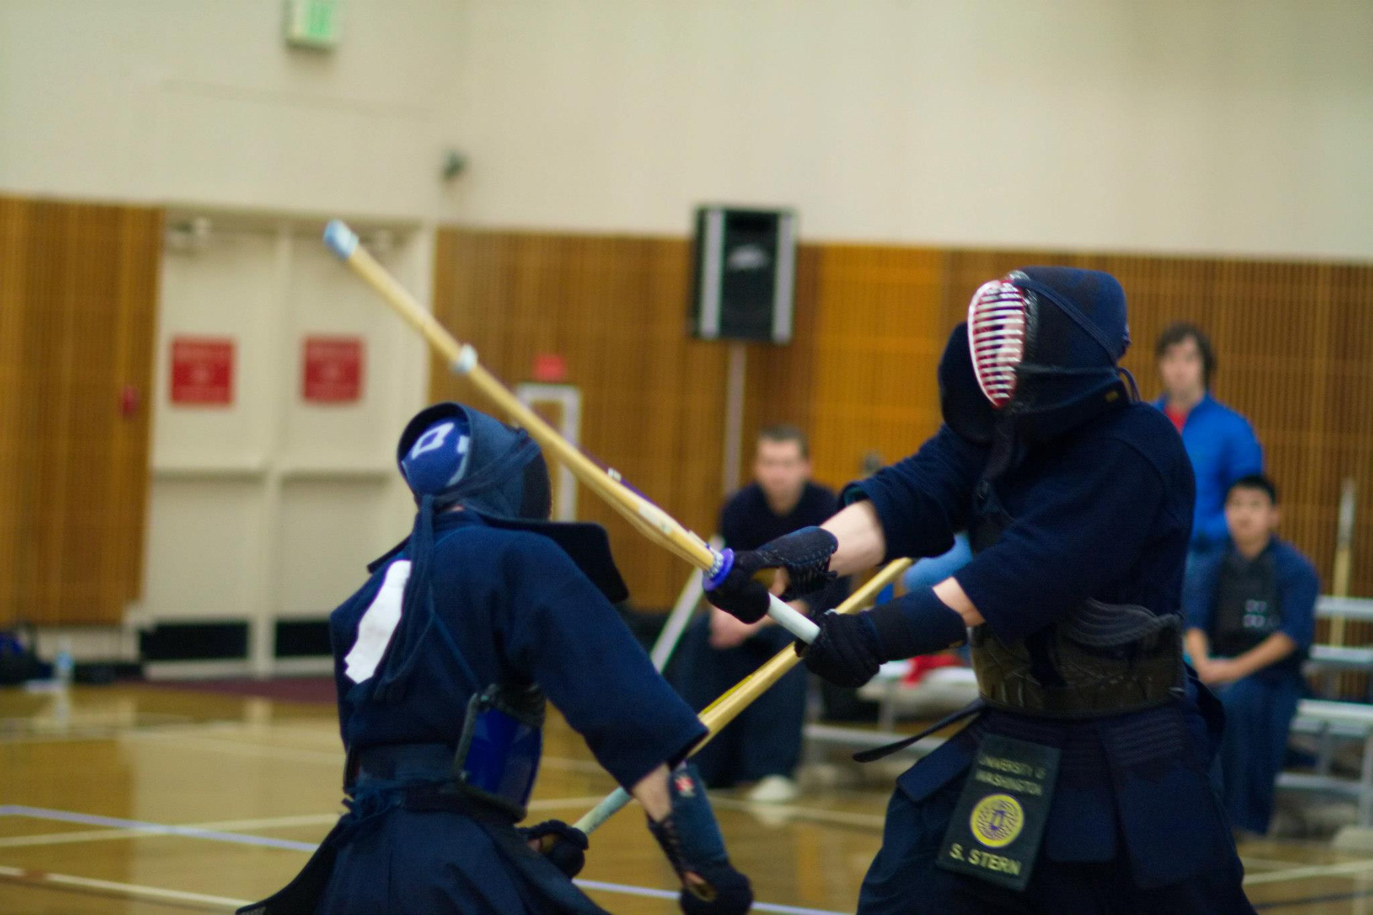
The Team – Shawn Stern
Major in EE, Embedded concentration
Minor in Technical/Business Japanese
Previously interned at Intel in Santa Clara
Working full-time at Intel (Aloha, OR) starting July as a PDE
Part-time head smasher

Slide 4
The Team – Dan Tran
Major in EE, Embedded System
Software Design Engineer in Test – at Spacelabs Healthcare
Leader at Agape Non-Profit Organization

Slide 5
Project Objectives
Create a robotic arm that can manipulate small objects
Mount the arm on a mobile platform
Develop an Android application for wireless control
Implement voice commands for the Android application
Add safety features and self-control

Slide 6
Why
Personal interest in and history with robotics
Desire to work with a robust, functional microcontroller and sensors of our own choosing
Curiosity about Android development and working with Google’s APIs
Challenge of developing scratch-made Arduino libraries and obstacle navigation in Java

Slide 7

Development Environment
Arduino Uno
PWM Control
Serial
SPI
Digital control
Android (Java)
Serial over Bluetooth
Voice recognition
Environment navigation

Slide 8
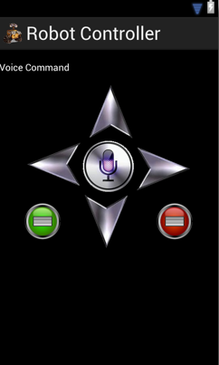
Current State

Slide 9
Changes and Other Possible Features
Compliment autonomous navigation with additional sensors to increase functionality
Temperature sensing, color and/or shape recognition
Different arm types for different purposes
Cutting tools, fire suppressant, etc.
Optional video feed for longer-range control

Slide 10
Difficulties
Multithreading
Distance sensor
Robot speed control
Servo motors
No issues with the Arduino itself!

Slide 11
Questions?

